Slide 1
Oracle GoldenGate on z/OS replicating to Oracle on Linux

Slide 2
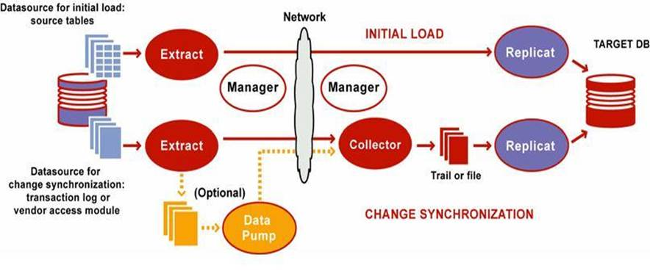
How GoldenGate works for Mainframe to midrange Oracle
Source on left is DB2 mainframe, target on right is midrange Oracle

Slide 3
RACF requirements for your id
You must have an OMVS segment for your RACFid (under TSO issue LU racfid and hit enter until you reach the end of the listing. The last screen will indicate if you have an OMVS segment or not)
This is probably handled by your RACF administration team and is beyond the scope of this presentation

Slide 4
Access to GoldenGate on z/OS
Logon to your LPAR
At the command prompt in ISPF enter OMVS
cd /web/oracle (Your directory may be different)
. ./ggenv.sh (note there is a space between dots) This sets up the GG environment vars
(your environment may have a different batch process)
cd goldengate
ggsci
At the command prompt in ISPF enter ISH to enter the ishell (ISPF like shell) where you can edit and look at the contents of the files

Slide 5
“Info all” to see the GG processes running
Suggested convention
Extracts begin with an E
pumps begin with a P
GGSCI (MVSLPAR1) 1> info all
Program Status Group Lag at Chkpt Time Since Chkpt
MANAGER RUNNING
EXTRACT RUNNING EDBL2 00:00:00 00:00:09
EXTRACT RUNNING PDBL2 00:00:00 00:00:03

Slide 6
“SHOW” output of ggsci
Using subdirectories for all process files
Editor: vi
Reports (.rpt) /MVSLPAR1/web/oracle/goldengate/dirrpt
Parameters (.prm) /MVSLPAR1/web/oracle/goldengate/dirprm
Replicat Checkpoints (.cpr) /MVSLPAR1/web/oracle/goldengate/dirchk
Extract Checkpoints (.cpe) /MVSLPAR1/web/oracle/goldengate/dirchk
Process Status (.pcs) /MVSLPAR1/web/oracle/goldengate/dirpcs
SQL Scripts (.sql) /MVSLPAR1/web/oracle/goldengate/dirsql
Database Definitions (.def) /MVSLPAR1/web/oracle/goldengate/dirdef
Dump files (.dmp) /MVSLPAR1/web/oracle/goldengate/dirdmp
Masterkey wallet files (.wlt) /MVSLPAR1/web/oracle/goldengate/dirwlt
Credential store files (.crd) /MVSLPAR1/web/oracle/goldengate/dircrd

Slide 7
Access to error logs
In the LPAR, logon to ISH and enter
cd /web/oracle/goldengate
Select file ggserr.log
Contains log messages since startup of GG
Look for the characters ERROR to find and error message, use ISPF editor commands to look for it
Messages are issued whenever GG stops as WARNING, the rest of the messages are INFO
If a process abends, look in /web/oracle/goldengate/dirrpt for files with the processid.dsc or processid.rpt, where processid is the extract or pump process name

Slide 8
Defgen for replicated tables
Generate the defgen and send it to the Oracle support DBA
In ISH on MVSLPAR1, rename the file /middleware/oraggt10/goldengate/dirdef/defgen.def to a backup name
In OMVS on MVSLPAR1, after setting up GG env vars,
enter ./defgen paramfile /middleware/oraggt10/goldengate/dirprm/def.prm
this generates a new version in the file you just renamed.
Copy to Oracle – using WinSCP
FTP the file below in binary to your PC and then SFTP it to the Oracle server from your PC.
On server.domain.com, rename the existing file in directory /ggs/OMZBGWU2/dirdef to append date
The host directory is
/middleware/oraggt10/goldengate /dirdef on MVSLPAR1.domain.com
File is nbdefgen.def (make sure to copy in binary)
Remote is server.domain.com to directory /ggs/OMZBGWU2/dirdef

